Slide 1
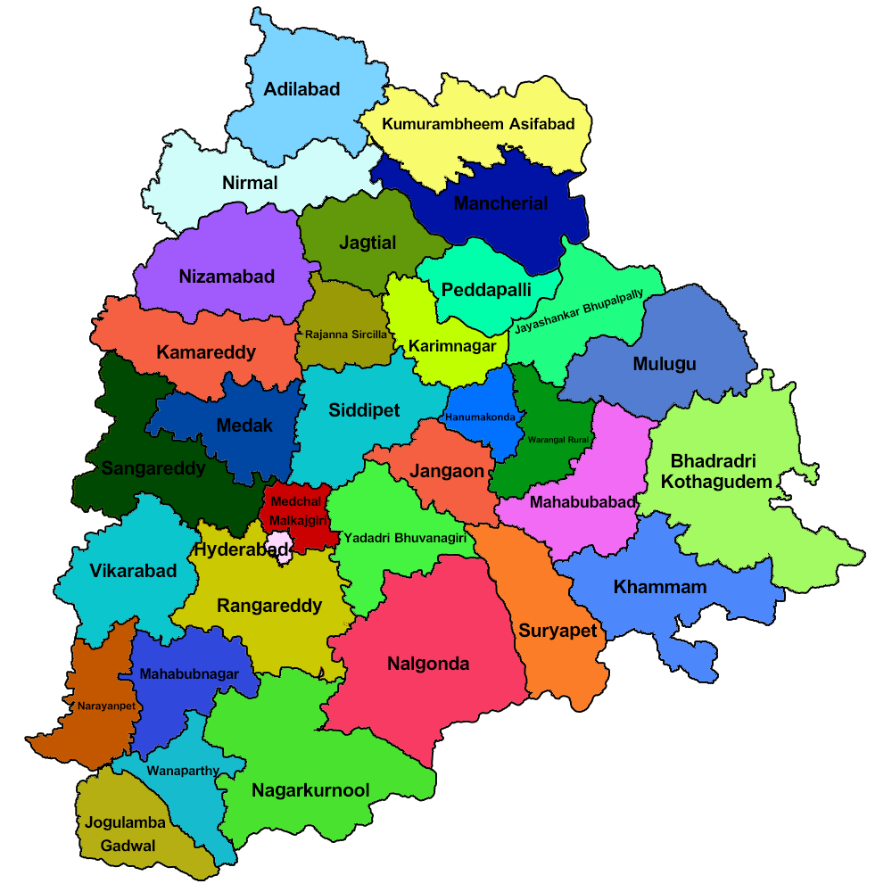


CODE BASICS RESUME PROJECT
#CHALLENGE - 7
Analyse Growth And Present Insights To The Telangana Government
OBJECTIVES :-
Stamp Registration Analysis
Transportation Analysis
Industrial Project Approval & Self-certification
System (IPASS) Analysis
4) Secondary Research

Slide 2
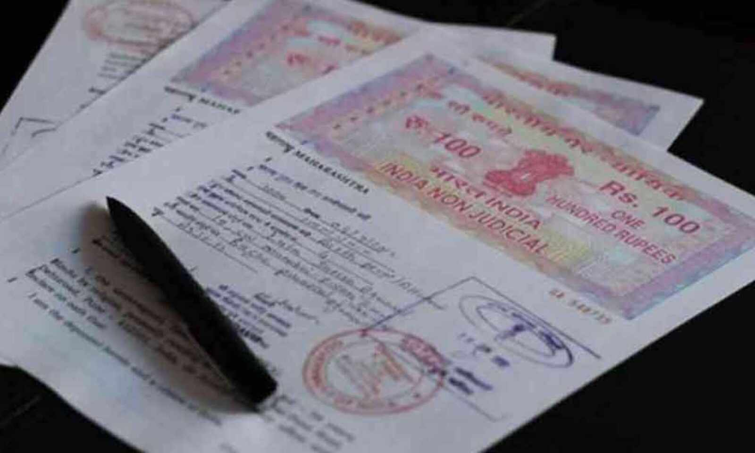
Stamp Registration Analysis

Slide 3
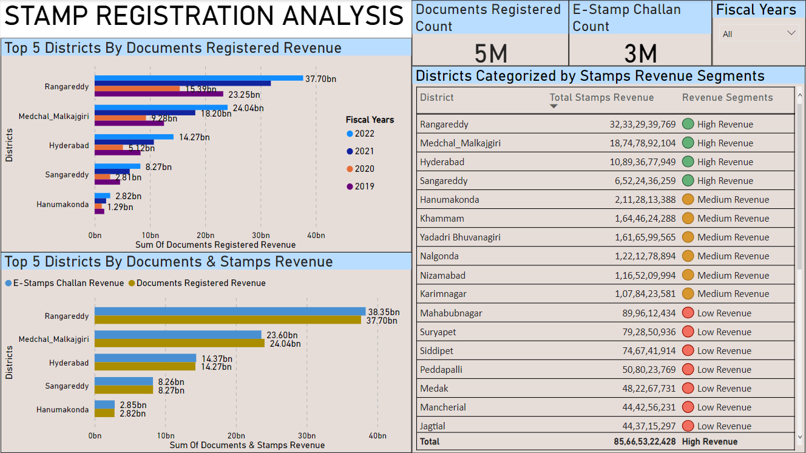

Slide 4
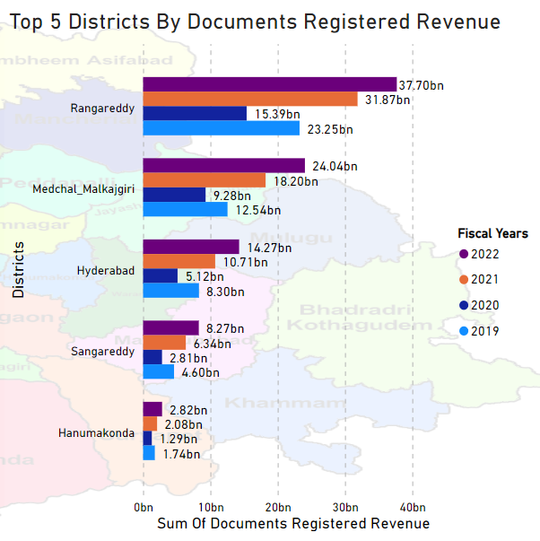
Q1. How does the revenue generated from document registration vary across districts in Telangana?
List down the top 5 districts that showed the highest document registration revenue growth between FY 2019 and 2022.
This visual represents on the top 5 districts by revenue generated from registered documents. The data pertains to the fiscal year between 2019 and 2022.
Impression :-
Overall, the analysis of the top 5 districts reveals that the highest revenue was achieved in the years 2021 and 2022, whereas the lowest revenue generation was observed in 2020, which coincided with the COVID-19 pandemic period.

Slide 5
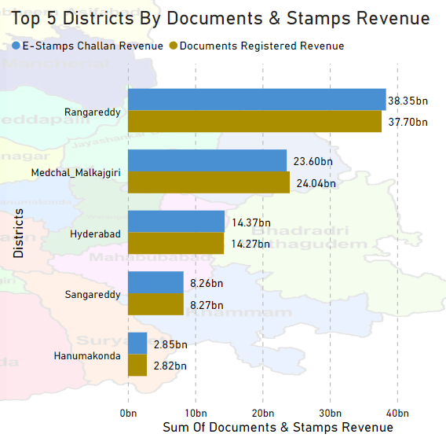
Q2. How does the revenue generated from document registration compare to the revenue generated from e-stamp challans across districts? List down the top 5 districts where e-stamps revenue contributes significantly more to the revenue than the documents in FY 2022?
This visual represents on the comparison of revenue generated from documents and stamps in the top 5 districts. The data pertains to the fiscal year 2022.
In Rangareddy district, revenue generation from E-stamps amounts to 38.35 billion, where as revenue generated through documents is slightly lower at 37.70 billion. Consequently, the primary source of revenue generation is attributed to E-stamps.
In Medchal Malkajgiri district, revenue generation from documents amounts to 24.04 billion, where as revenue generated through E-stamps is slightly lower at 23.60 billion. Consequently, the primary source of revenue generation is attributed to documents.
In Hyderabad district, revenue generation from E-stamps amounts to 14.37 billion, where as revenue generated through documents is slightly lower at 14.27 billion. Consequently, the primary source of revenue generation is attributed to E-stamps.
In Sangareddy district, revenue generation from documents amounts to 8.27 billion, where as revenue generated through E-stamps is slightly lower at 8.26 billion. Consequently, the primary source of revenue generation is attributed to documents.
In Hanumakonda district, revenue generation from E-stamps amounts to 2.85 billion, where as revenue generated through documents is slightly lower at 2.82 billion. Consequently, the primary source of revenue generation is attributed to E-stamps.

Slide 6
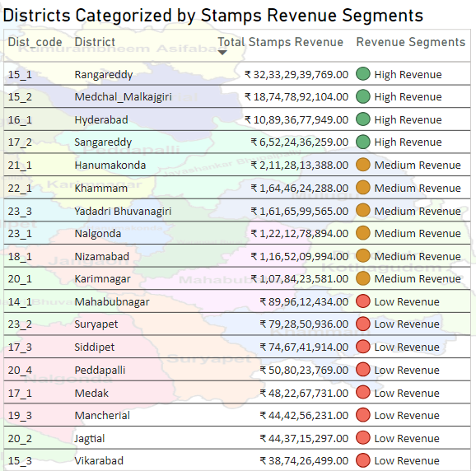
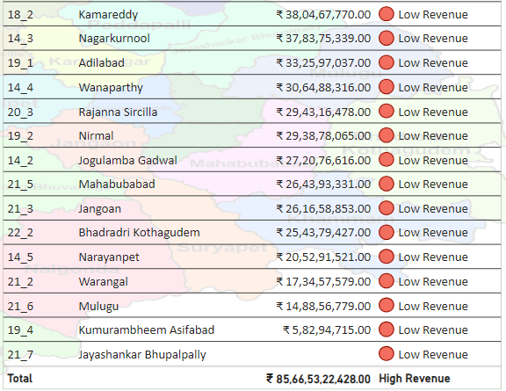
Q3. Categorize districts into three segments based on their stamp registration revenue generation during the fiscal year 2021 to 2022
This table highlights districts based on segments of stamps revenue. The data presented corresponds to the fiscal years spanning from 2021 to 2022.
Impression :- In the analysis of revenue segmentation, there are a total of four districts with the highest revenue, six districts with medium revenue, and twenty three districts with low revenue.

Slide 7
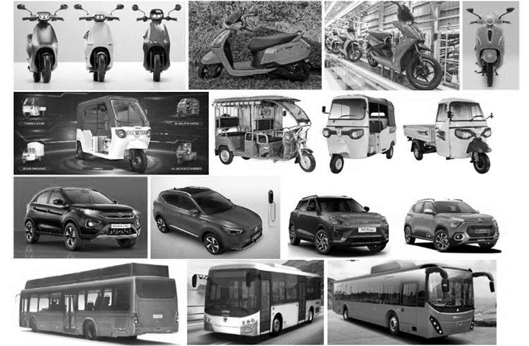
Transportation
ANALYSIS

Slide 8
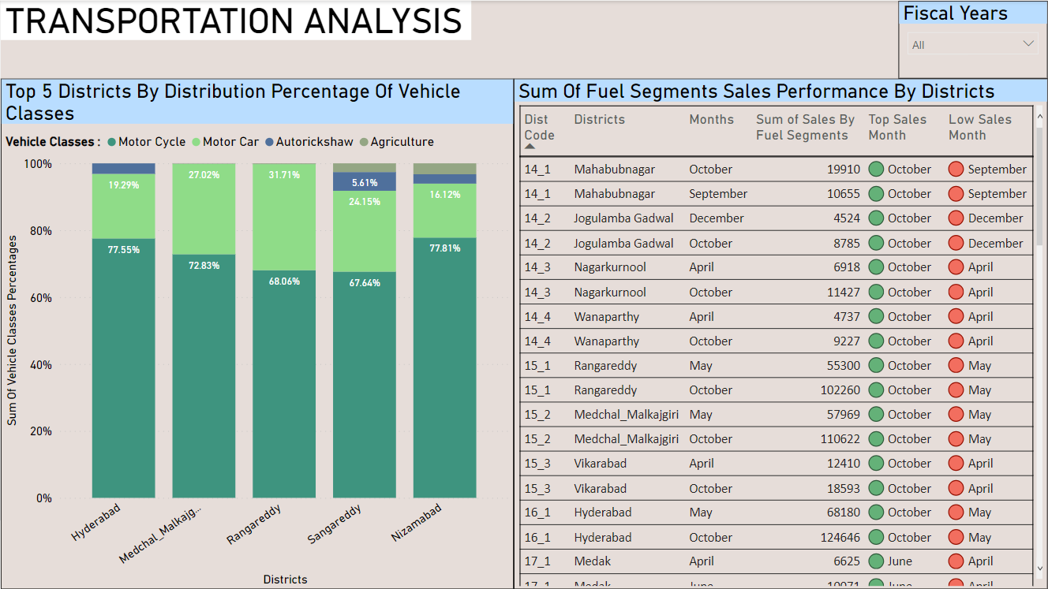

Slide 9
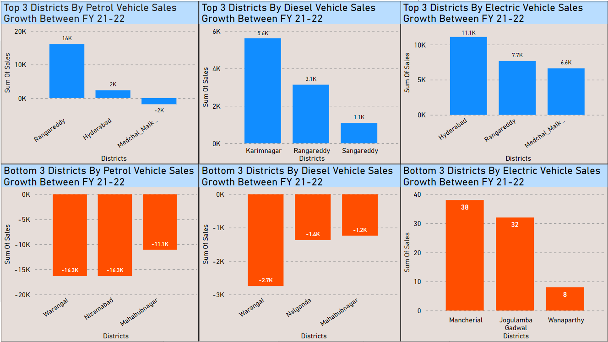

Slide 10
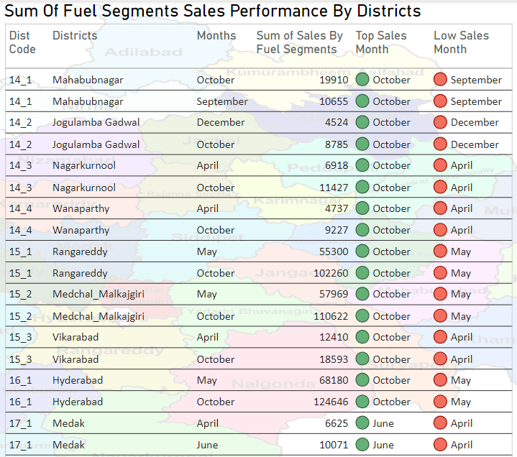
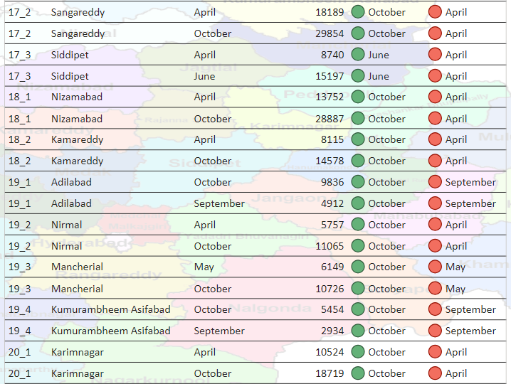
Q1. Investigate whether there is any correlation between vehicle sales and specific months or seasons in different districts. Are there any months or seasons that consistently show higher or lower sales rate, and if yes, what could be the driving factors? (Consider Fuel-Type category only)
This table highlights districts and specific months with the highest and lowest sales based on the total sales of four fuel segments (Sum Of Sales by Fuel Segments). The sales calculations cover the fiscal years from 2019 to 2022.

Slide 11
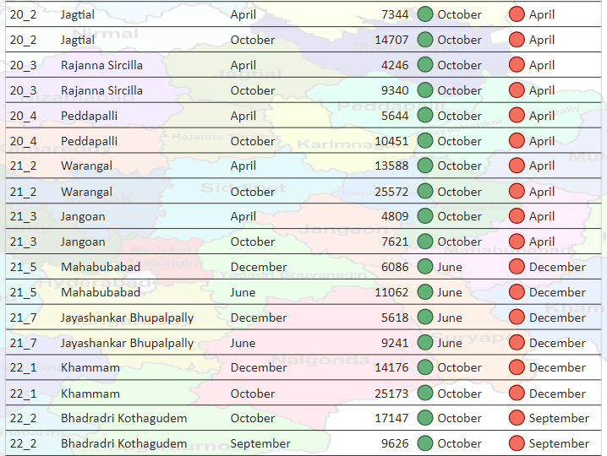
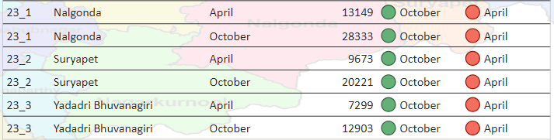
Impression :- In this analysis of total sales across four segments, it's evident that the majority of districts achieve their highest sales in the total fuel category during October and June. Conversely, lower sales are observed in the months of April, May, September, and December.

Slide 12
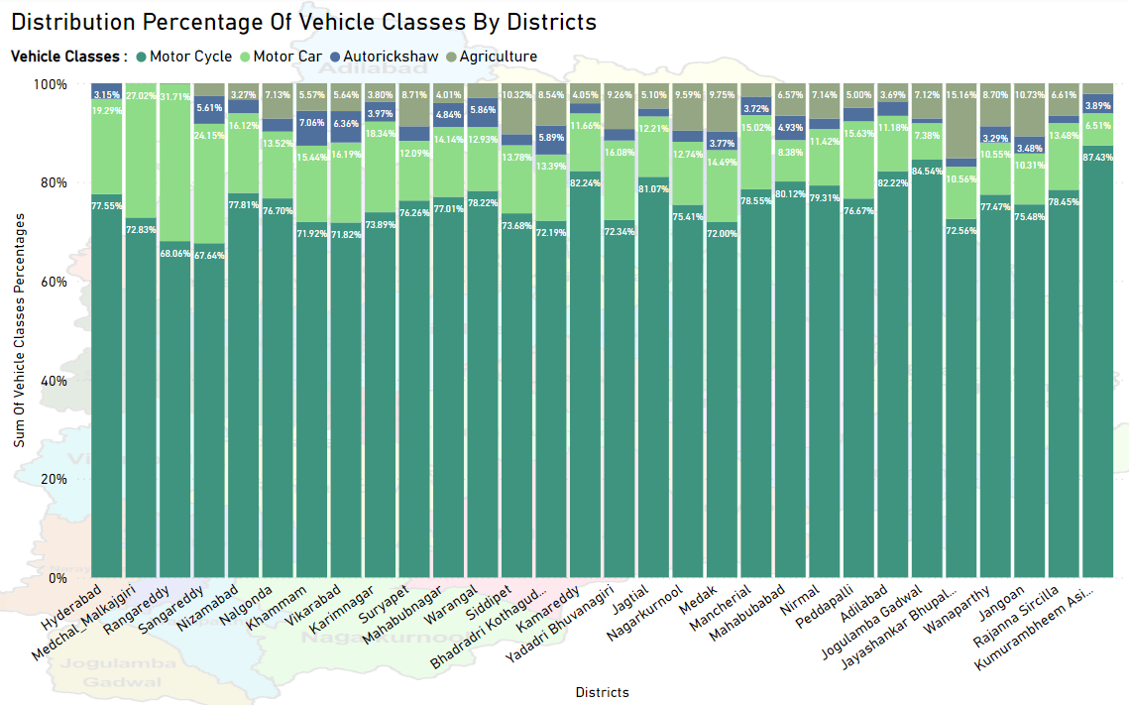
Q2. How does the distribution of vehicles vary by vehicle class (Motor Cycle, Motor Car, AutoRickshaw, Agriculture) across different districts? Are there any districts with a predominant preference for a specific vehicle class? Consider FY 2022 for analysis.
This visual represents the predominant distribution of vehicle classes in districts. The data pertains to the fiscal year 2022
Impression :- In the analysis of the distribution of vehicle classes in all districts, the major and highest distribution of vehicle classes is motorcycles.

Slide 13
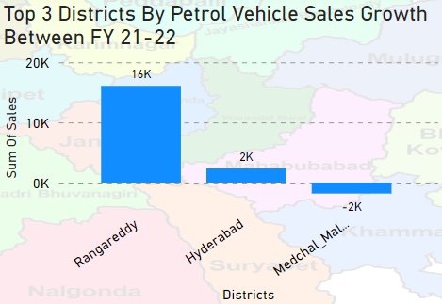
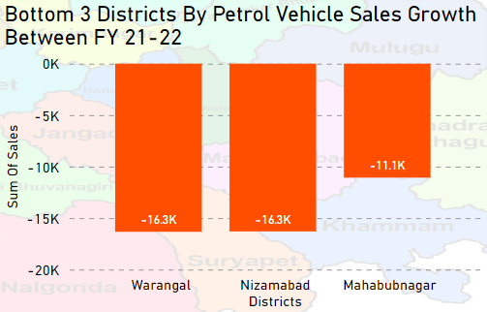
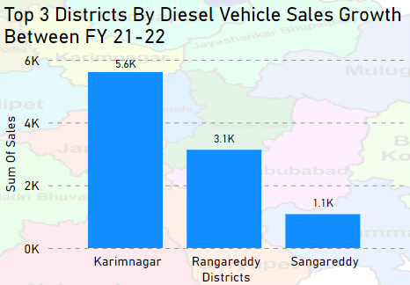
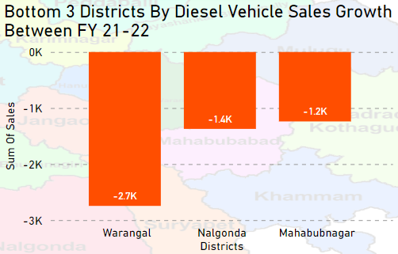
Q3. List down the top 3 and bottom 3 districts that have shown the highest and lowest vehicle sales growth during FY 2022 compared to FY 2021? (Consider and compare categories: Petrol, Diesel and Electric)
This visual presents the growth of vehicle sales between FY 2021 and FY 2022
Impression :- In the comparison of petrol vehicle sales growth between FY21 and FY22, the top 3 districts are Rangareddy, Hyderabad, and Medchal Malkajgiri. The bottom districts, in terms of sales growth, are Warangal, Nizamabad, and Mahabubnagar.
Impression :- In the comparison of Diesel vehicle sales growth between FY21 and FY22, the top 3 districts are Karimnagar, Rangareddy, and Sangareddy. The bottom districts, in terms of sales growth, are Warangal, Nalgonda, and Mahabubnagar.

Slide 14
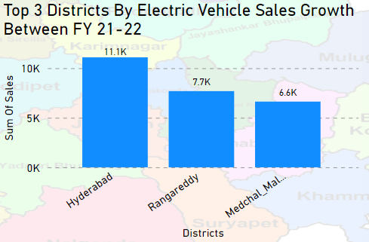
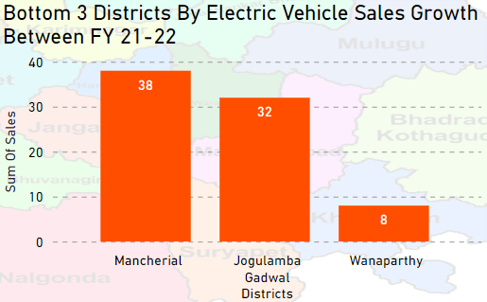
Impression :- In the comparison of Electric vehicle sales growth between FY21 and FY22, the top 3 districts are Hyderabad, Rangareddy and Medchal Malkajgiri. The bottom districts, in terms of sales growth, are Mancherial, Jogulamba Gadwal, and Wanaparthy.

Slide 15

TS - IPASS ANALYSIS
(Telangana State Industrial Project Approval and Self Certification System)

Slide 16
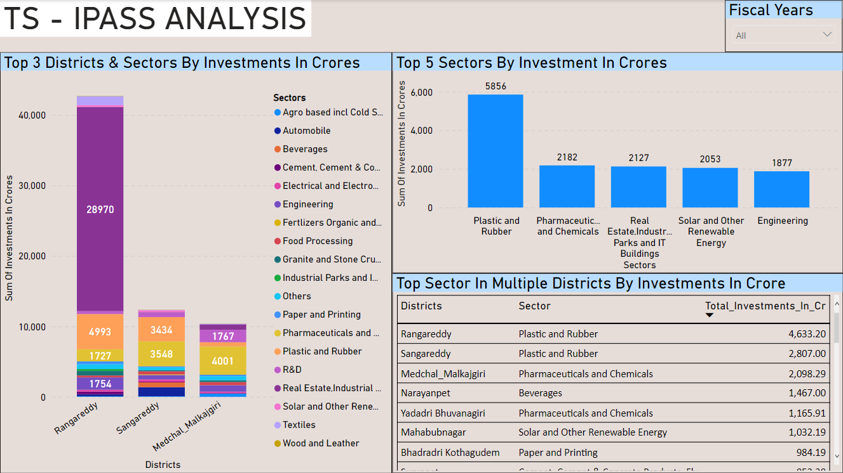

Slide 17
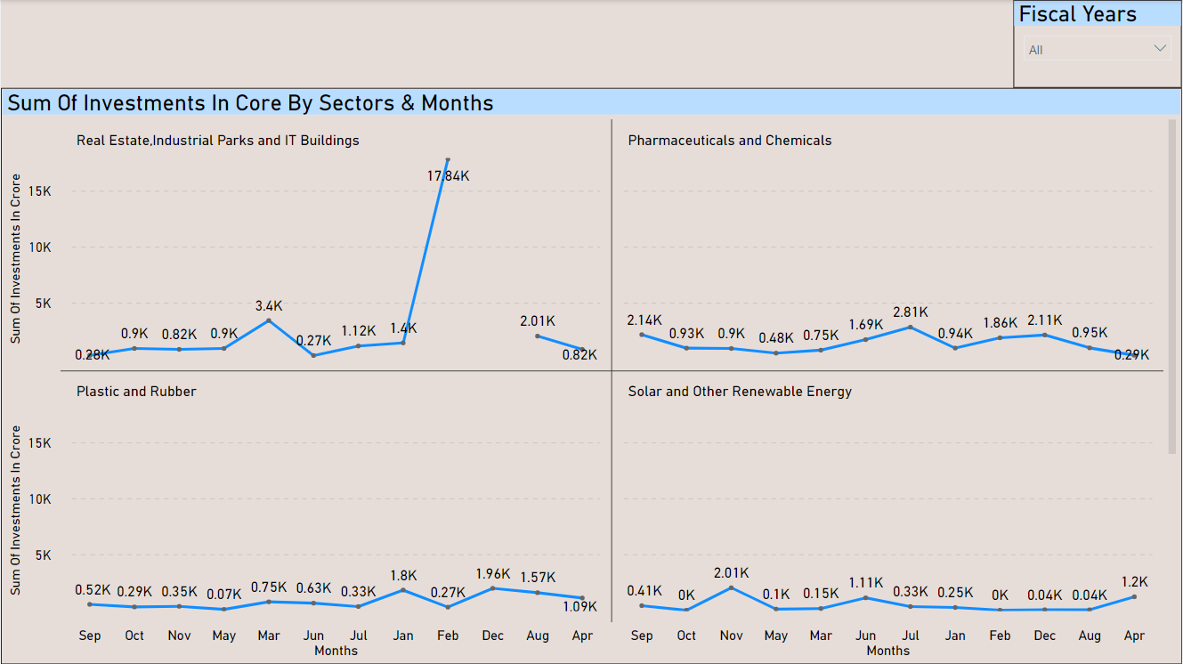

Slide 18
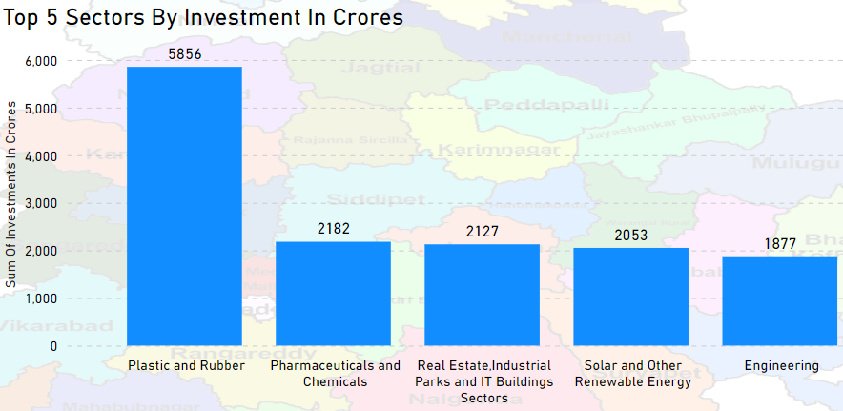
Q1. List down the top 5 sectors that have witnessed the most significant investments in FY 2022.
Impression :-
In the analysis of investments in various sectors, the top five sectors by investment amount are as follows:
Plastic & Rubber: 5856 Cr
Pharmaceuticals & Chemicals: 2182 Cr
Real Estate, Industrial Parks & IT Buildings: 2127 Cr
Solar & Other Renewable Energy: 2053 Cr
Engineering: 1877 Cr

Slide 19
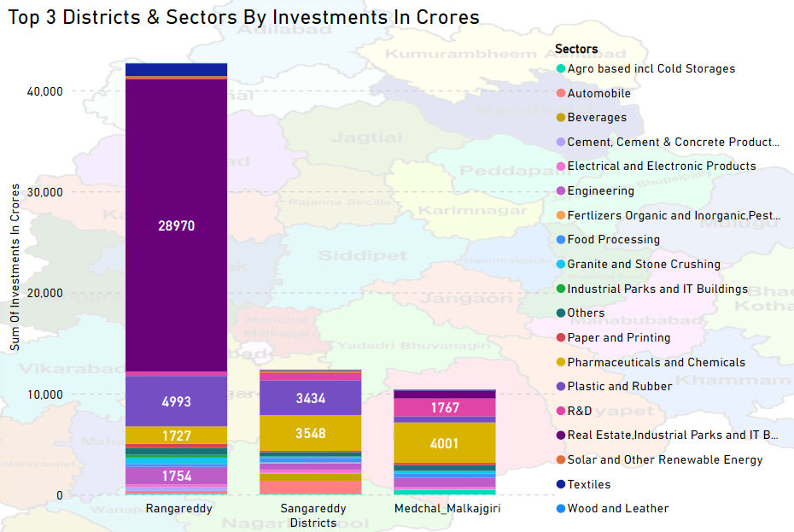
Q2. List down the top 3 districts that have attracted the most significant sector investments during FY 2019 to 2022? What factors could have led to the substantial investments in these particular districts?
Impression :-
In the analysis of substantial sector investments, the top 3 districts with significant investments in specific sectors are as follows:
Rangareddy: This district has made significant investments totaling 28,970 Crores in the Real Estate, Industrial Parks, and IT Buildings sector.
2. Sangareddy: Significant investments of 3,548 Crores have been channeled into the Pharmaceuticals and Chemicals sector in Sangareddy.
3. Medchal Malkajgiri: The Pharmaceuticals and Chemicals sector in Medchal Malkajgiri has attracted substantial investments amounting to 4,001 Crores.

Slide 20
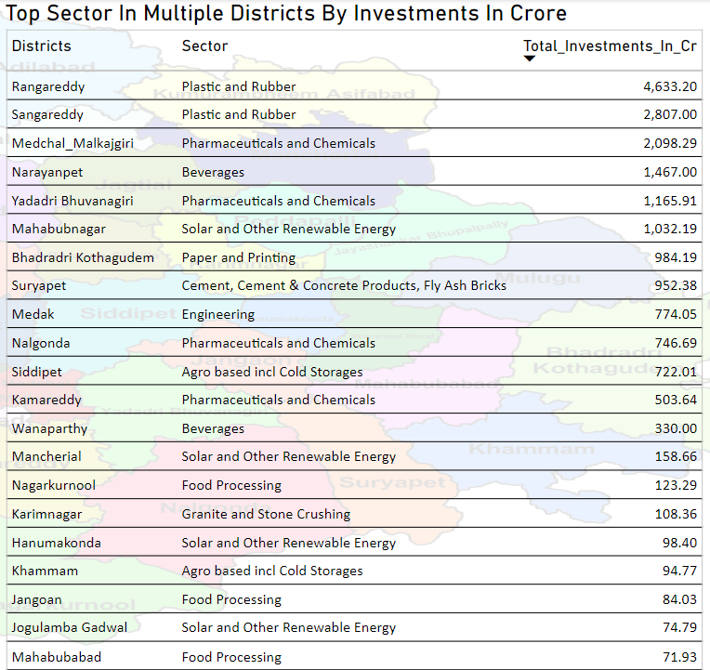
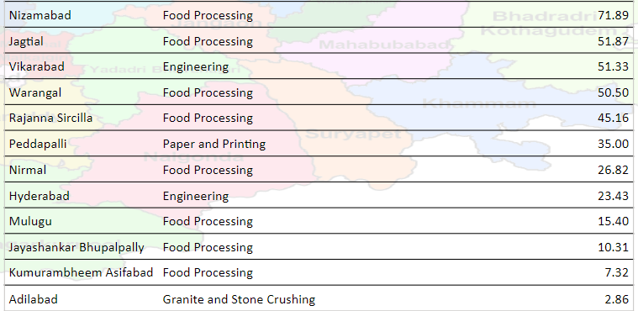
Q3. Are there any particular sectors that have shown substantial investment in multiple districts between FY 2021 and 2022?
Impression :- In this analysis, it has been observed that the sectors of Plastic & Rubber, Pharmaceuticals & Chemicals, Beverages, Solar & other renewable energy, Paper & Printing, Cement, Cement & Concrete Products (including Fly Ash Bricks), Engineering, Agro-Based (including Cold Storages), Food Processing, and Granite & Stone Crushing are the top sectors in various districts by investments in core.

Slide 21
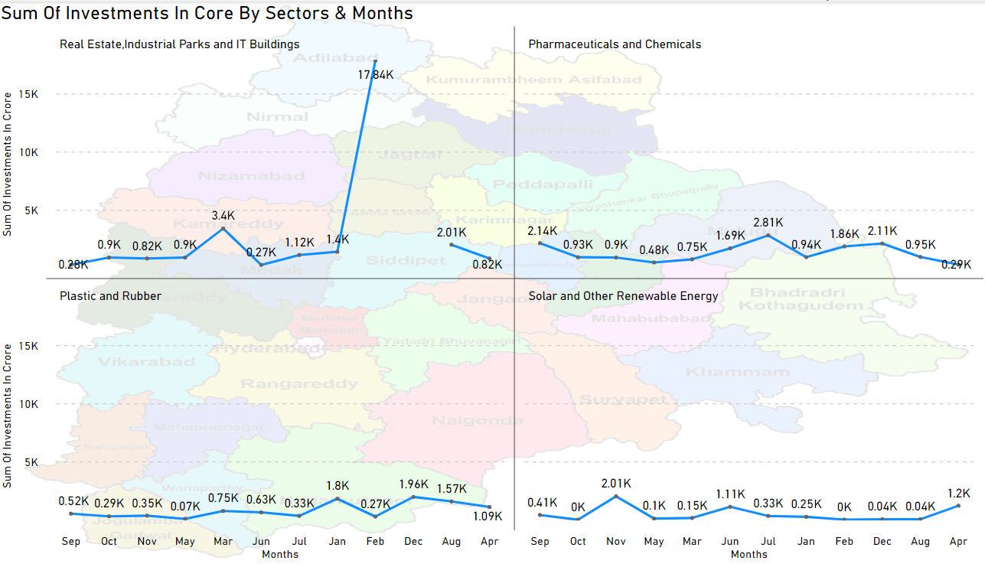
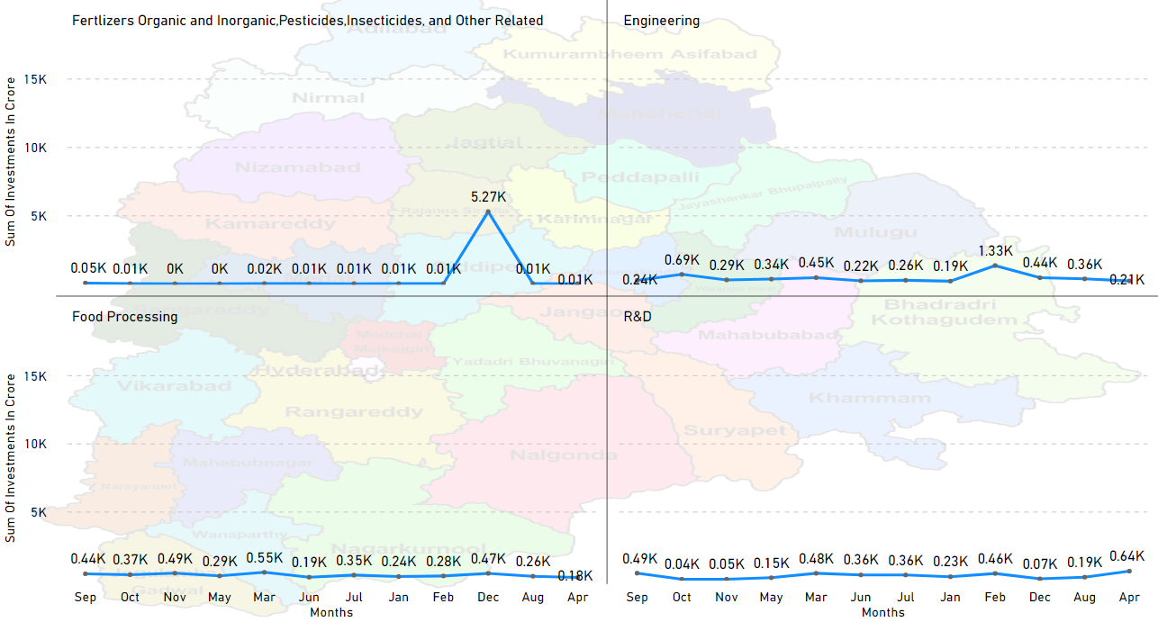
Q4. Can we identify any seasonal patterns or cyclicality in the investment trends for specific sectors? Do certain sectors experience higher investments during particular months?

Slide 22
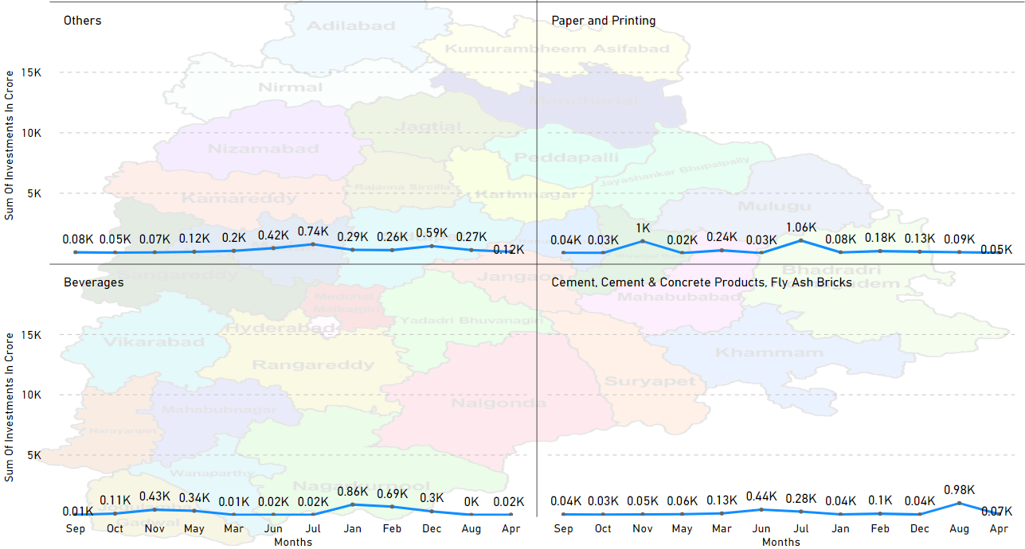
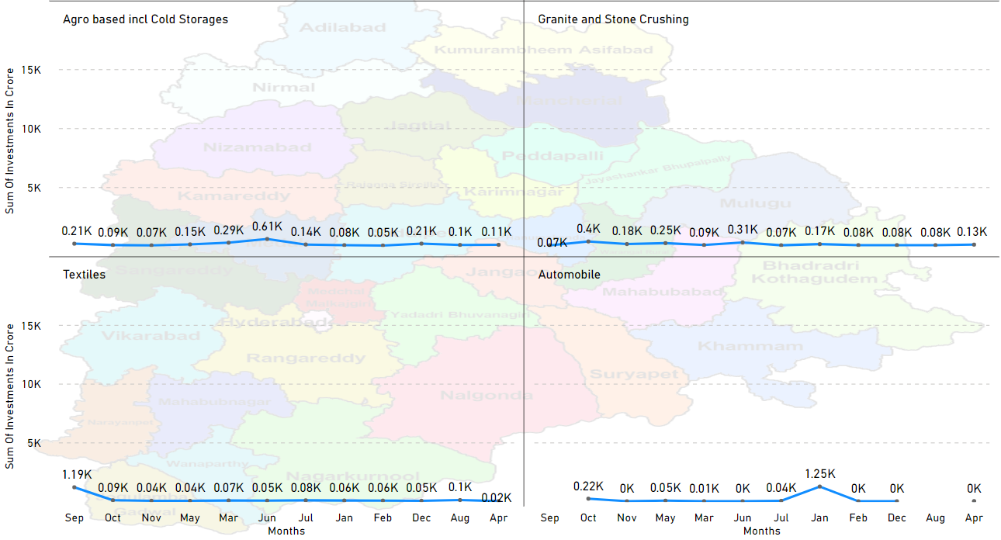

Slide 23
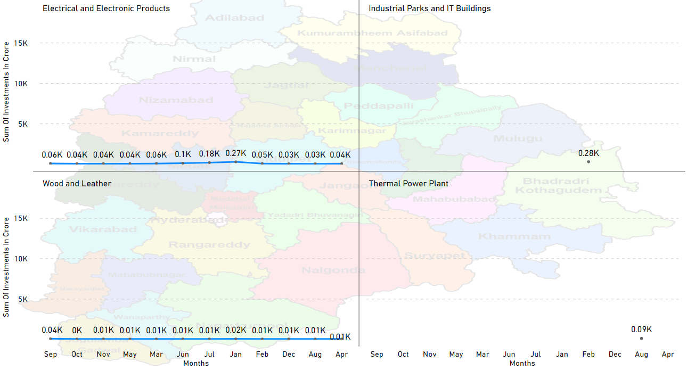

Slide 24

Secondary
Research

Slide 25
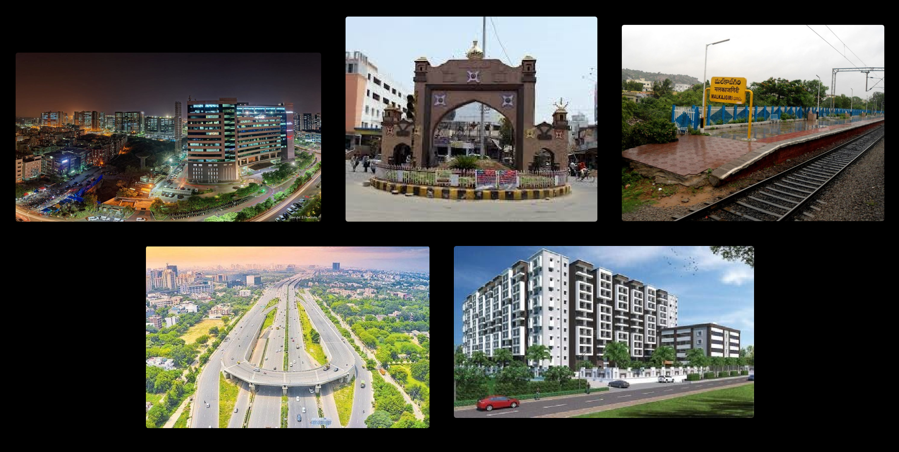
Q1. What are the top 5 districts to buy commercial properties in Telangana? Justify your answer.
Solution :-
By analyzing the Telangana government dataset, my opinion is buying commercial properties in Telangana districts are,
Rangareddy
Sangareddy
Medchal Malkajgiri
Hyderabad
Karimnagar

Slide 26
Q2. What significant policies or initiatives were put into effect to enhance economic growth, investments, and employment in Telangana by the current government? Can we quantify the impact of these policies using available data?
Solution :-
Support for Entrepreneurs and Business Funds: Providing policies and funds to support entrepreneurs and businesses is a common strategy to stimulate economic growth. This can include access to startup funds, tax incentives, and business development programs. Such initiatives can help new businesses flourish and contribute to economic growth.
2. Support for IT Startups: Encouraging the growth of IT startups can indeed lead to employment opportunities and economic growth. The IT sector often has a high potential for job creation and innovation, making it a strategic focus for many regions.
3. Investment in Key Industries: Focusing on key industries like real estate, pharmaceuticals & chemicals, engineering, rubber & plastic, and renewable energy can be a sound strategy. These sectors often have a multiplier effect on the economy and can create jobs not only within the industry itself but also in related sectors of the economy.

Slide 27
Q3. Provide top 5 Insights & 5 recommendations to Telangana government for sustained growth in the next 5 years based on your analysis
Recommendations :-
Startup Ecosystem Development: Create a supportive ecosystem for startups by establishing more incubators and accelerators, simplifying regulations, and providing access to early-stage funding. This will stimulate innovation and entrepreneurship.
Revenue Generation: Review and adjust fees for e-stamps and document registration to generate additional revenue for government projects and initiatives. Ensure that these changes are fair and don't burden the public excessively.
Electric Vehicle Hub: Collaborate with industry leaders and provide incentives to attract electric vehicle manufacturers to Telangana. Develop the necessary infrastructure, such as charging stations and research facilities, to support the growth of the EV industry.
Investment Promotion: Promote Telangana as an attractive investment destination in various sectors, including real estate business, manufacturing, renewable energy, and pharmaceuticals. Offer incentives, streamline regulatory processes, and provide infrastructure to facilitate investments.
Social Welfare Enhancement: Strengthen and expand social welfare programs aimed at marginalized communities, with a focus on healthcare access, education, and poverty alleviation. Monitor and evaluate the impact of these programs to ensure effective outcomes.

Slide 28

Name : Vijay Vithal Joshi
Tools Used : Excel, SQL, Power BI, PowerPoint
Data Source : Open Data Telangana

